Slide 1


SMART INDIA HACKATHON 2026
Problem Statement ID – SIH26027
Problem Statement Title – AI-POWERED AUTOMATIC BLOCK PLANNING TO MAXIMIZE ASSET AVAILABILITY FOR TRAIN OPERATIONS ON INDIAN RAILWAYS
Theme – TRANSPORTATION & LOGISTICS
PS Category – Software
Team ID –
Team Name(Registered on portal) – TEAM KAVACH

Slide 2

KAVACH BIE –AI POWERED BLOCK PLANNING FOR INDIAN RAILWAYS
Team
Kavach
AI
S
Real World Issue : Difficulties in track maintenance, Train delays, Route conflicts, Operational disruption
KAVACH BIE AI
SOLUTION
KAVACH BIE DELIVERS
-
Minimum
Train Disruption
-
Better Track Utilization
-
Improved Punctuality
-
Cost & Time Efficiency
PRIMARY FUNCTIONS
Why Important : Poorly timed maintenance blocks create effect of delays , reduce railway punctuality & Operational efficiency
AI-POWERED BLOCK WINDOW OPTIMIZATION
TRAIN SCHEDULE & TRAFFIC ANALYSIS
Solution : Kavach BIE proposes an AI-assisted optimization engine automatically generates feasible block schedules to minimize operational disruption
MONITORING & SUPPORT
REAL TIME
MONITORING
PREDICTIVE DELAY ANALYTICS
STAKEHOLDER NOTIFICATION
AUTOMATED REPORTING
CONTINUOUS REPORTING

Slide 3
Team
Kavach
TECHNICAL APPROACH
KAVACH BIE
AI Optimization Engine
Finds the optimal block window with minimum disruption
1.TRAIN DATA INPUT
->Train Schedules
->Historical Delays
->Traffic Density
->Route information
2.MAINTENANCE NEEDS
->Track maintenance request
->Block duration->Priority of maintenance
->Resource availability
3.AI ANALYSIS & OPTIMIZATION
->Analyzes train movement
->Checks constraints & rules
->Predicts delays
->Runs Optimization
algorithm
4.Conflict check
->Detects schedule conflicts
->Validate safety constraints
->Ensures operational feasibility
->Checks regulatory rules
5.Optimal Block Window
->Best time for block
->Minimum train disruption
->Maximum track utilization
->Balanced Operations
6.Monitor & Adapt
->Real time monitoring
->Track block Execution
->Feedback & learning
->Continuous improvement
TECHNOLOGY STACK
FRONTEND
HTML | CSS | JavaScript | React.js
BACKEND
Python | FastAPI
AI/ML
Pandas | NumPy | Scikit-learn
OPTIMIZATION
Constraint-based Optimization Algorithms
DATABASE
MySQL | PostgreSQL
Visualization & Deployment
Plotly | Chart.js & Cloud | Docker

Slide 4



FEASIBILITY AND VIABILITY
Team
Kavach
FEASIBILITY ANALYSIS
VIABILITY
BUSINESS POTENTIAL
Uses existing railway data – schedules,delays,traffic & track information
AI/Optimization can automate manual block planning
Can integrate with existing railway systems through APIs
Scalable from prototype -> real world deployment
Reduces manual planning effort and human errors
Minimizes train disruption and maintenance
Improves track utilization and maintenance efficiency
Real time monitoring enables continuous improvement
Can be deployed for Indian railways and railway operators
B2B/B2G software solution for railway zones and maintenance teams
Potential for subscription/licensing +system integration revenue

Slide 5
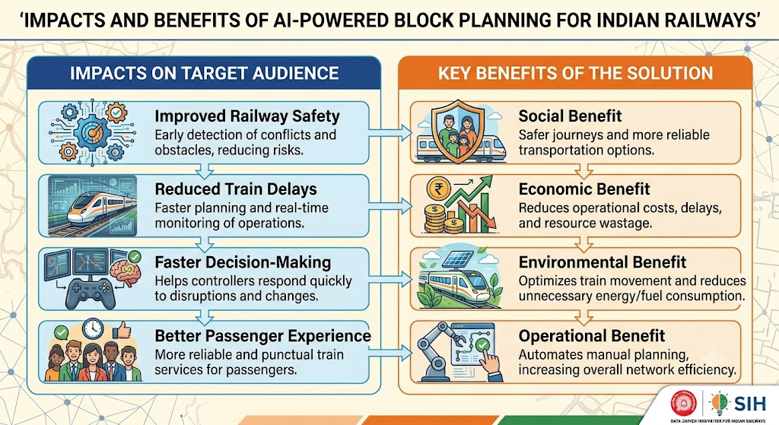
Team
Kavach
IMPACT AND BENEFITS

Slide 6

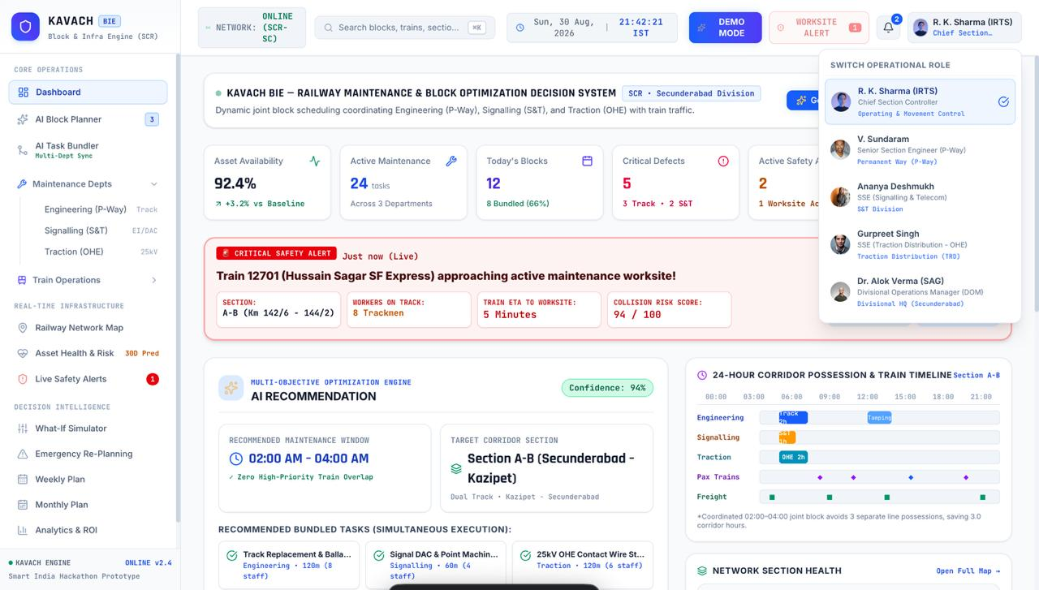
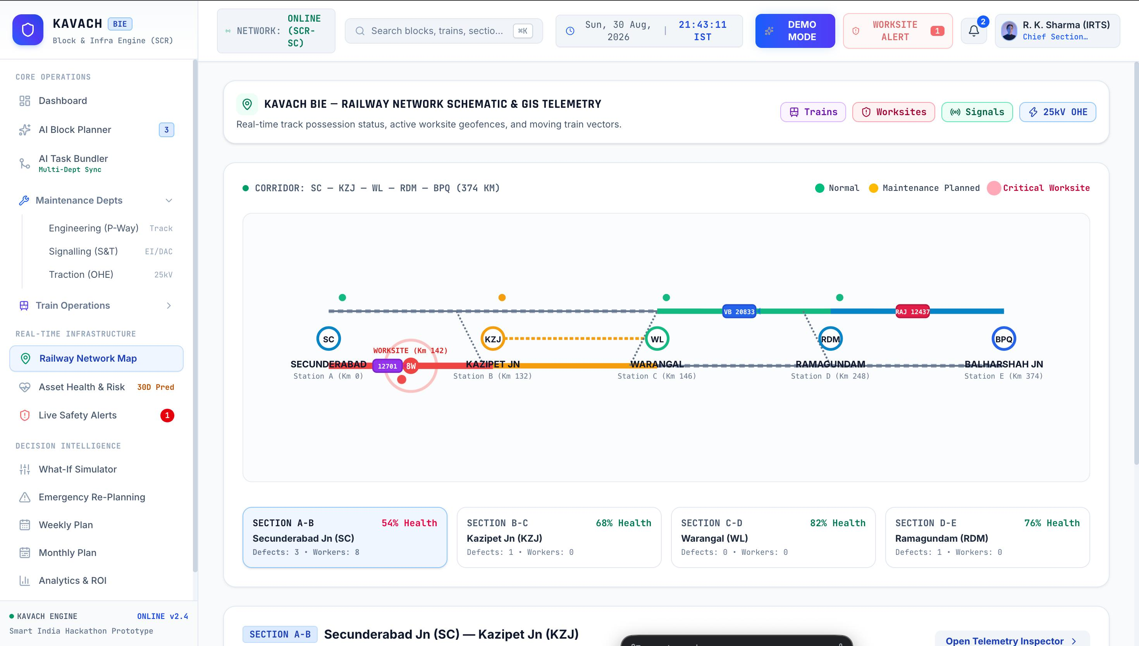
Team
Kavach
RESEARCH AND REFERENCES
Journal of Rail Transport Planning & Management :Resource considerations for integrated planning of railway traffic and maintenance windows – ScienceDirect
Development of a maintenance possession scheduler for railway: Development of a maintenance possession scheduler for a railway
Railway Operations : [IRFCA] Indian Railways FAQ - Railway Operations — II
Railway Maintenance Scheduling & Optimization : Research portal Eindhoven University of Technology
Railway Maintenance Possession Scheduling : The South African Journal of Industrial Engineering

